Slide 1


eLJF-CLINICAL
Quick 6-step tutorial in just 3 minutes

Slide 2
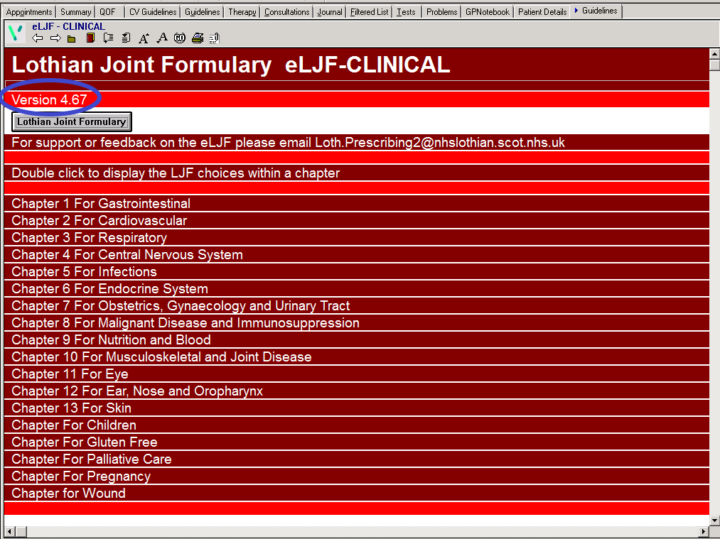
Step 1
Check version
  Do you have a ‘tab’ for eLJF-CLINICAL installed on your clinical profile?
  Is the current version of eLJF-CLINICAL installed?
  You can check the formulary website to confirm that you have the correct version of
  eLJF-CLINICAL.

Slide 3
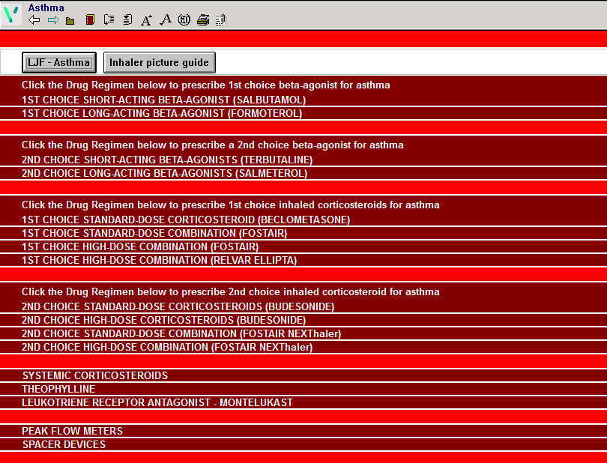
Step 2
Prescribe formulary first choice
  Identify and prescribe the first line combination inhaler for asthma.
  Note that there is a standard dose and high dose option.
  Click here for more information on acute/ repeat prescribing on VISION

Slide 4
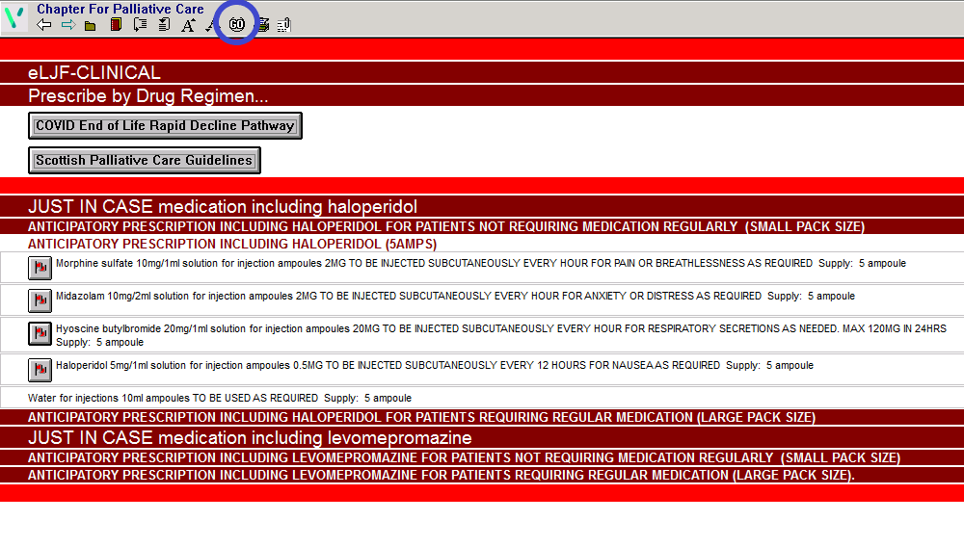
Step 3
Use the ‘GO’ button
  The ‘GO’ button can be used to select multiple products within a drug regimen.
  The best example is when prescribing ‘just in case’ medicines for palliative care.
  This technique can also be used when prescribing for H. pylori eradication. The result is a highly accurate prescription with the correct dosing instructions.

Slide 5
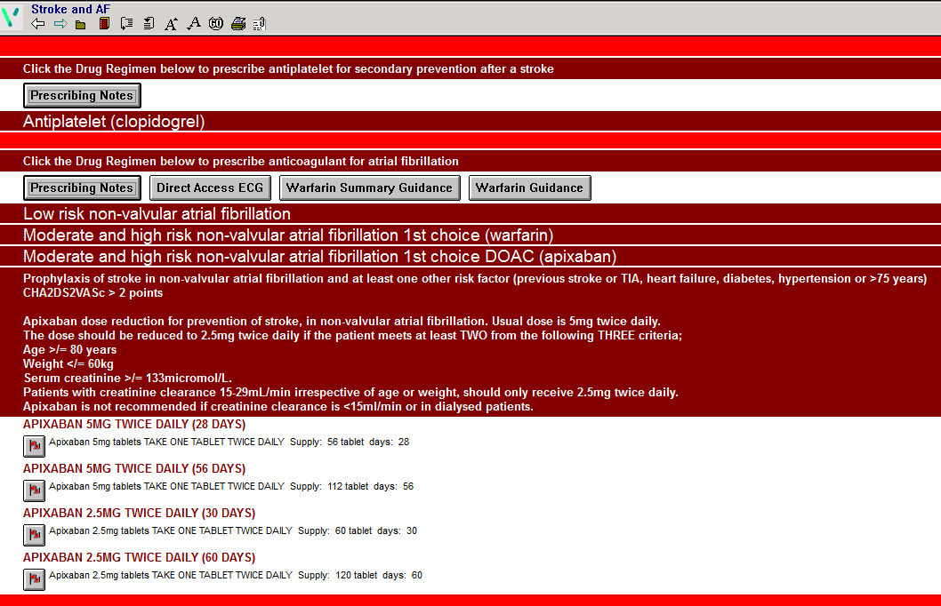
Step 4
Prescribe an anticoagulant for AF
  Note that eLJF-CLINICAL provides selected prescribing information and buttons linking to useful resources to help ensure a safe and effective prescription

Slide 6
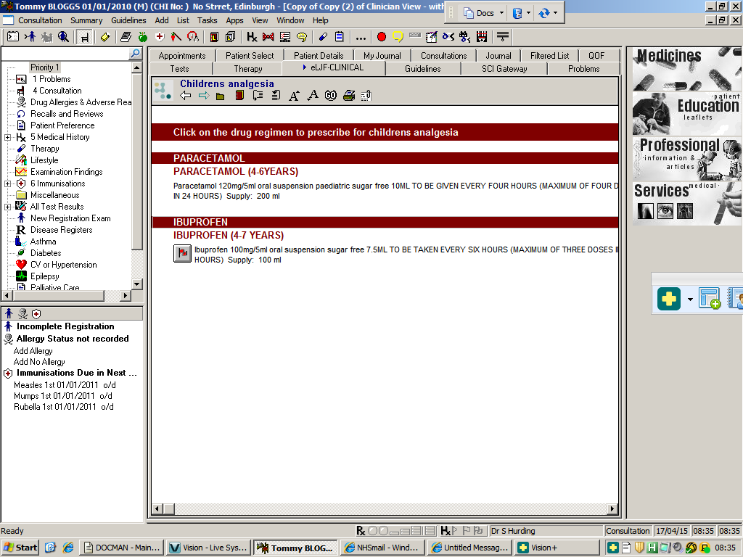
Step 5
Prescribe for a child
  Select a child “dummy” patient.
  The children’s chapter of eLJF-CLINICAL uses age-specific filters to obtain the correct dose of medicine.
  Prescribe paracetamol for a 5-year-old child: note that the dosing is correct as per current MHRA and formulary guidance.
  The accurate dosing instruction helps to ensure an adequate dose of analgesia is used.

Slide 7
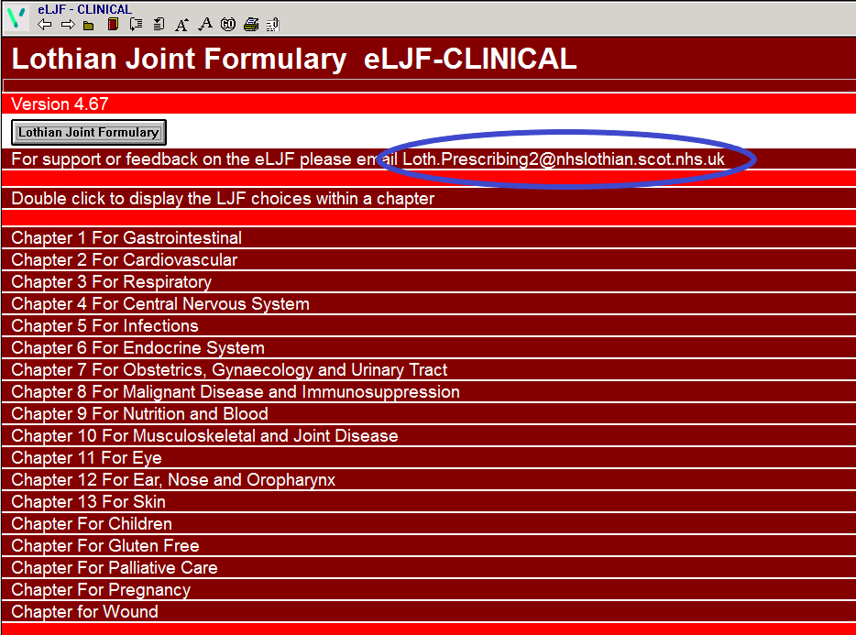
Step 6
Needing more help?
You can contact the Medicines Management Team for more support or to provide feedback on: Loth.prescribing2@nhslothian.scot.nhs.uk

